Slide 1
Chapter 10
The Stack
Stack data structure
Interrupt I/O (again!)
Arithmetic using a stack

Slide 2
Stack Data Structure
Abstract Data Structures
  are defined simply by the rules for inserting and extracting data
The rule for a Stack is LIFO (Last In - First Out)
  Operations:
    Push (enter item at top of stack)
    Pop (remove item from top of stack)
  Error conditions:
    Underflow (trying to pop from empty stack)
    Overflow (trying to push onto full stack)
  We just have to keep track of the address of top of stack (TOS)

Slide 3
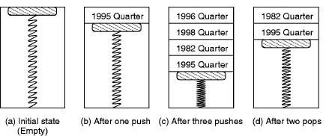
A “physical” stack
A coin holder as a stack

Slide 4
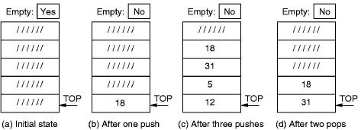
A hardware stack
Implemented in hardware (e.g. registers)
  Previous data entries move up to accommodate each
  new data entry
    Note that the Top Of Stack is always in the same place.

Slide 5
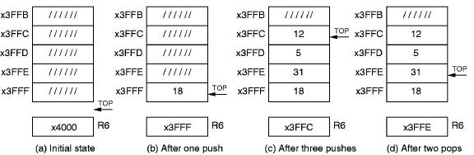
A software stack
Implemented in memory
  The Top Of Stack moves as new data is entered
    Here R6 is the TOS register, a pointer to the Top Of Stack

Slide 6
Push & Pop
Push
  Decrement TOS pointer (our stack is moving down)
  then write data in R0 to new TOS
Pop
  Read data at current TOS into R0
  then increment TOS pointer
PUSH ADD R6, R6, # -1
STR R0, R6, # 0
POP LDR R0, R6, # 0
ADD R6, R6, # 1

Slide 7
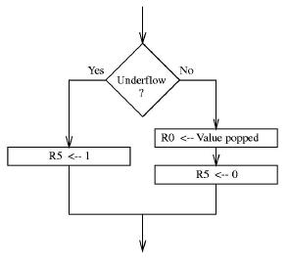
Push & Pop (cont.)
What if stack is already full or empty?
  Before pushing, we have to test for overflow
  Before popping, we have to test for underflow
  In both cases, we use R5 to report success or failure

Slide 8
PUSH & POP in LC-3
POP ST R2, Sv2 ;save, needed by POP
ST R1, Sv1 ;save, needed by POP
LD R1, BASE ;BASE contains x-3FFF
ADD R1, R1, # -1 ;R1 now has x-4000
ADD R2, R6, R1 ;Compare SP to x4000
BRz fail_exit ;Branch if stack is empty
LDR R0, R6, # 0 ;The actual ‘pop’
ADD R6, R6, # 1 ;Adjust stack pointer
BRnzp success_exit

Slide 9
PUSH & POP in LC-3 (cont.)
PUSH ST R2, Sv2 ;needed by PUSH
ST R1, Sv1 ;needed by PUSH
LD R1, MAX ;MAX has x-3FFB
ADD R2, R6, R1 ;Compare SP to x4004
BRz fail_exit ;Branch is stack is full
ADD R6, R6, # -1 ;Adjust Stack Pointer
STR R0, R6, # 0 ;The actual ‘push’

Slide 10
PUSH & POP in LC-2 (cont.)
success_exit LD R1, Sv1 ;Restore register values
LD R2, Sv2 ;
AND R5, R5, # 0 ;R5 <-- success
RET
;
fail_exit LD R1, Sv1 ;Restore register values
LD R2, Sv2
AND R5, R5, # 0
ADD R5, R5, # 1 ;R5 <-- fail
RET
BASE .FILL xC001 ;Base has x-3FFF
MAX .FILL xC005 ;Max has x-4004
Sv1 .FILL x0000
Sv2 .FILL x0000

Slide 11
Interrupt-driven I/O (again!)
We can now finish servicing the interrupt!
  Remember that an INT signal “hijacks” the CPU, diverting it without warning from processing the program.
  We left two questions hanging in our earlier treatment of interrupt handling:
    How do we save enough information about the current program to be able to pick up where we left off after servicing the interrupt? And
    How do we reset the CPU to deal with the Interrupt Service Routine?
  In both cases, the answer has to do with state (remember the Finite State Machine?), and the use of stacks.

Slide 12
The State of a Program
State is a “snapshot” of the system
  The complete state specification would include the contents of relevant memory locations, the general purpose registers, and some special registers, including the PC and …
Introducing … the PSR
  or Processor Status Register
  which stores the most important pieces of information about the current program
15 14 13 12 11 10 9 8 7 6 5 4 3 2 1 0
Pr ---PL--- N Z P
Privilege Priority Level Condition codes

Slide 13
The PSR
Privilege
  PSR[15] indicates whether the current program is running in Supervisor (0) or User (1) mode
    This allows some resources to be kept “off limits” to non-OS programs
Priority
  PSR[10:8] stores the priority level of the current program
    There are 8 levels of priority, from PL0 (lowest) to PL7 (highest).
Condition Codes
  PSR[2:0] stores the current NZP condition codes

Slide 14
Saving the state - 1
We only need to save the PC and the PSR
  We assume that the ISRs will be smart enough to save relevant Registers (remember “callee save”?)
  The PC and the PSR between them hold enough state information to be able to reconstitute the program when needed.
Where do we save them?
  On a stack!
    Remember, there might be nested interrupts, so simply saving them to a register or reserved memory location would not work.

Slide 15
The Supervisor Stack
Only Supervisors can use the Supervisor Stack!
  The User stack & the Supervisor stack are in separate regions of memory
    The stack pointer for the current stack is always R6.
    If the current program is in privileged mode, R6 points to the Supervisor stack, otherwise it points to the user stack.
    Two special purpose registers, Saved.SSP and Saved.USP, are used to store the pointer currently not in use, so the two stacks can share push/pop subroutines without interfering with each other.

Slide 16
Saving the state - 2
When the CPU receives an INT signal …
  The privilege mode changes from User to Supervisor mode
    PSR[15] <= 0
  The User stack pointer is saved & the Supervisor stack pointer is loaded
    Saved.USP <= (R6)
    R6 <= (Saved.SSP)
  PC and PSR are pushed onto the Supervisor Stack
    Now the CPU is free to handle the interrupting device!

Slide 17
Loading the state of the ISR
Vectored interrupts
  Along with the INT signal, the I/O device transmits its priority level and an 8-bit vector (INTV).
  If the interrupt is accepted, INTV is expanded to a 16-bit address:
    The Interrupt Vector Table resides in locations x0100 to x01FF and holds the starting addresses of the various Interrupt Service Routines. (similar to the Trap Vector Table and the Trap Service Routines)
    INTV is an index into the Interrupt Vector Table, i.e. the address of the relevant ISR is ( x0100 + Zext(INTV) )
  The address of the ISR is loaded into the PC
  The PSR is set as follows:
    PSR[15] <= 0 (Supervisor mode)
    PSR[10:8] is set to the priority level of the interrupting device
    PSR[2:0] <= 000 (no condition codes set)

Slide 18
Returning from the Interrupt
The last instruction of an ISR is RTI
  Return from Interrupt (opcode 1000)
  Pops PSR and PC from the Supervisor stack
  Restores the condition codes from PSR
  If necessary (i.e. if the current privilege mode is User) restores the user stack pointer to R6 from Saved.USP
  Continues running the program as if nothing had happened!

Slide 19
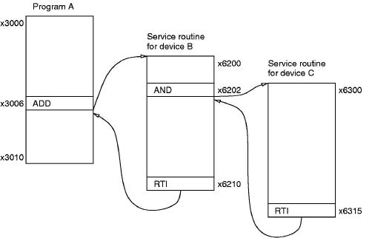
Interrupts illustrated

Slide 20
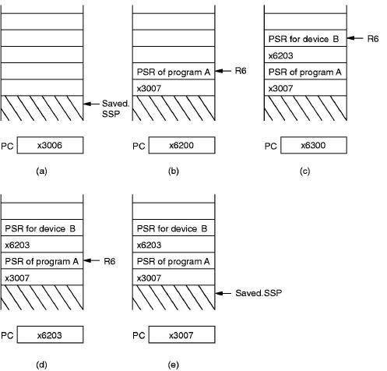
Supervisor Stack & PC during INT

Slide 21
Stack as an alternative to Registers
Three-address vs zero-address
  The LC-3 explicitly specifies the location of each operand: it is a three-address machine
    e.g. ADD R0, R1, R2
  Some machines use a stack data structure for all temporary data storage: these are zero-address machines
    the instruction ADD would simply pop the top two values from the stack, add them, and push the result back on the stack
    Most calculators use a stack to do arithmetic, most general purpose microprocessors use a register bank

